Slide 1
Needs tree
Skopje, 28/09/2018

Slide 2
Problem tree
The Problem Tree Analysis belongs to the family of participatory planning techniques, in which all parties involved identify and analyse the needs together.
Participatory methods aim to create ownership and commitment among the involved parties

Slide 3
The Problem tree
The main output of the exercise is a tree-shaped diagram in which the trunk represents the focal problem, the roots represent its causes and the branches its effects.
Such a problem tree creates a logical hierarchy of causes and effects and visualizes the links between them.
It creates a summary picture of the existing negative situation.

Slide 4
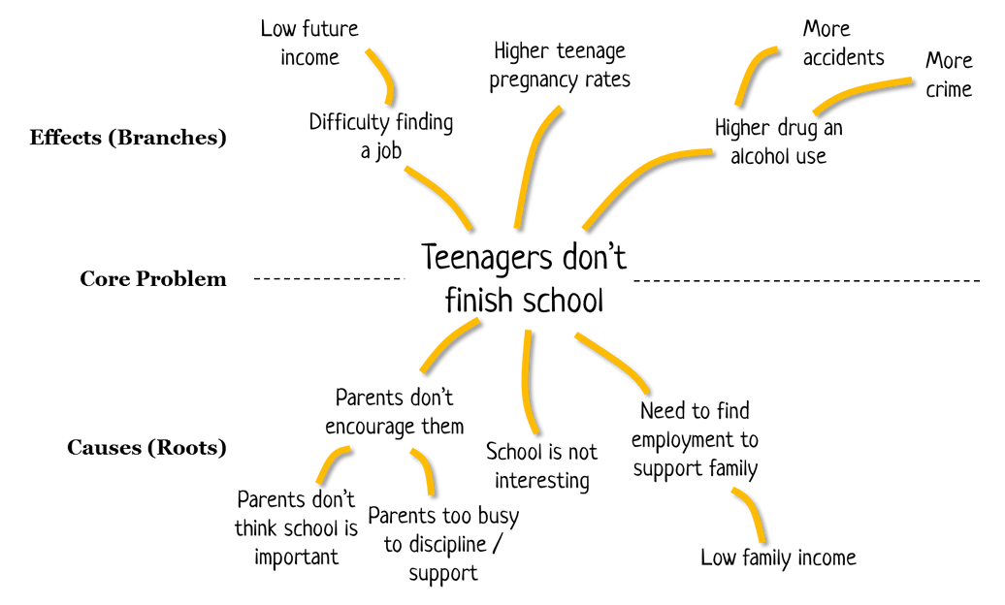
Problem tree

Slide 5
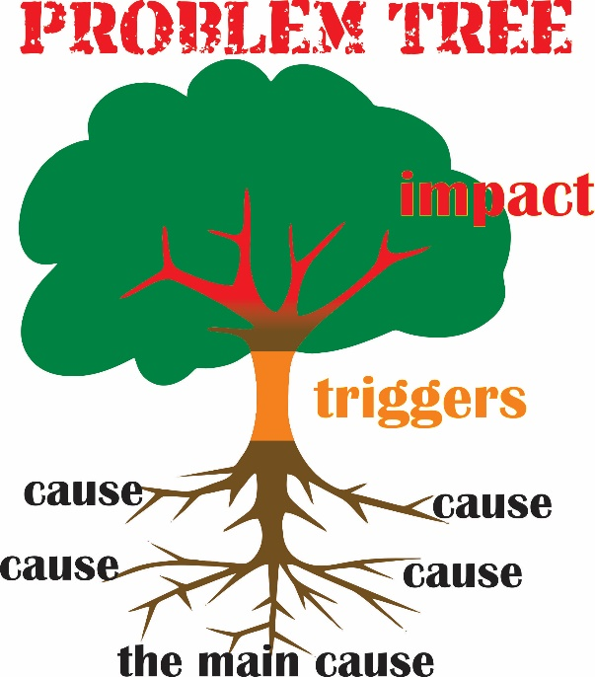
Problem tree

Slide 6
Task 1
Split in groups of max 6 people (as much mixed as possible)
Choose a name for your group
15 minutes: think and discuss about “problems” related to your role as a trainer

Slide 7
Task 2
Define the core problem (focal problem or central point)
Write it down on a paper
Formulate the causes effects (consequences) of the core problem, and put them on the post it above or below the core problem according to the causes/effect relationship

Slide 8
Hints
Be careful about how you describe the problems:
“lack of money to go to school”
Instead: “Fees school are not affordable” could open up discussion about other ways to answer the problem.

Slide 9
Present the problem tree…

Slide 10
Any questions for the other group?

Slide 11
Switch the groups!

Slide 12
Task 3 Objective tree
Reformulate the negative situations into positive situations that are desirable and realistically achievable
E.g. “teenager drop out”, is converted into “teenagers complete the school”
10 min

Slide 13
Action wanted
Switch the groups!
The group will
Go back to the Problem tree they have developed
Read, discuss and adjust if necessary the solutions found by the other group
Develop an Action Plan by reflecting on “what skills and experience can we offer to address the ‘problems’ and reach the “objectives”?

Slide 14
Action plan
Choose 2 specific objectives and develop an action plan.
Be specific: add timeframe and indicators ☺
10 min

Slide 15
Action wanted
How will you determine your priority for the intervention?
What resources do you have as a group?
What areas can you influence and for what are you responsible? Is this your ‘line of control’?
Does this reflect how you think change happens ?

Slide 16
Action plan
Share it

Slide 17
Why the problem tree?

Slide 18
Why the problem tree?
The heart of the exercise is the discussion, debate and dialogue that is generated as factors are arranged and re-arranged
To develop a shared perception of problems
To enhance engagement and commitment among all participants: learners, trainers, school directors, families…
To enhance critical thinking
To improve active citizenship
Autonomy Belonginess Competence, and…

Slide 19
And…

Slide 20
And
The problem can be broken down into manageable and definable chunks.
This allows a clearer prioritisation of factors and helps focus objectives;

Slide 21
To conclude…
The process of analysis helps to build a shared sense of Understanding
Purpose
Action

Slide 22
Obrigada
Tank
Merci
Grazie Thanks
Falla
Dank Gracias

